Slide 1
Financial Analysis Dashboard
Interactive Power BI Report
Presented By:
Pranathi Deshapaka

Slide 2
Dashboard Objective
Purpose:
To provide stakeholders with a dynamic, real-time overview of business performance using interactive visualizations.
Focus Areas:
Sales Trends
Profitability
Regional Performance
Product and Segment Analysis

Slide 3
Key Metrics (KPIs)
Total Sales: $6,095,282
Total Profit: $985,351
Profit Margin: 16.2%
Filters Available: Year, Segment, Country

Slide 4
Interactivity Features
Slicers for Year, Segment, and Country
Tooltips on hover
Drill-down and cross-filtering
Responsive layout with live data

Slide 5
Business Insights & Recommendations
strong performance in Central region — invest more in marketing there
Profit margins stable — look into cost-cutting for low-performing products
Consider expanding successful product lines based on Top 10 analysis

Slide 6
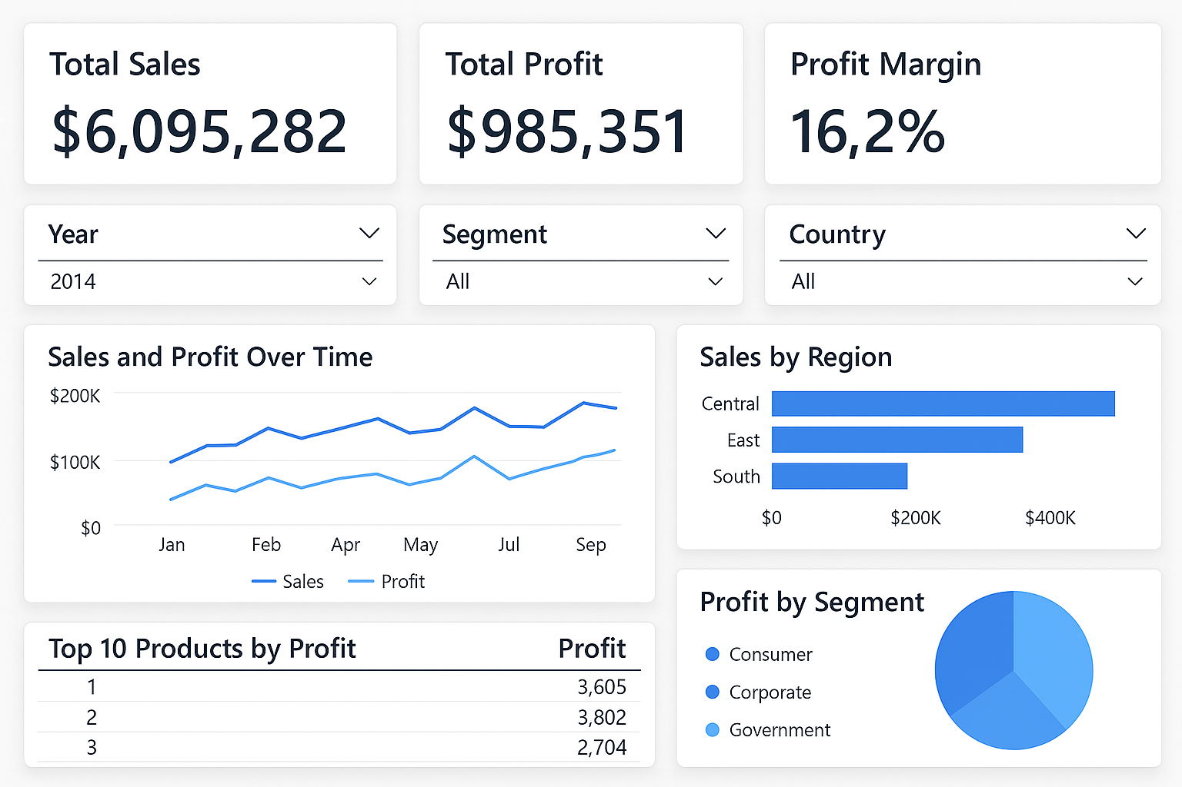
Screenshot of Dashboard

Slide 7
Key Insights
1. Strong Revenue Generation
Total Sales: $6.1M+
Sales performance is consistently strong across most months.
Certain months show noticeable peaks, indicating seasonal demand patterns
2. Profitability is Healthy
Total Profit: ~$985K
Profit Margin: ~16.2% — stable and within industry standards.
Most profitable products are clustered within a few key categories.
3. Central & East Regions Dominate Sales
Central region leads in overall sales, followed closely by the East and South.
Regional performance highlights where to double down on growth and marketing efforts.
4. Segment-Wise Profit Distribution
Consumer and Corporate segments contribute the most to profit.
Government segment has lower profit contribution — may require re-evaluation or new strategies.
5. Top Products Drive Significant Profit
The top 10 products account for a major chunk of total profit.
Suggests the 80/20 rule applies (focus on what drives the most return).

Slide 8
Conclusion
The dashboard provides a comprehensive and interactive view of the company’s performance:
Enables quick decision-making with real-time KPIs.
Highlights key areas of growth and underperformance.
Offers drill-downs for strategic planning (region, product, segment).

